Slide 1







DYNAMIC ENTITIES IN .NET
Building Low-Code Systems on Top of Entity Framework Core
Download the Presentation
Halil İbrahim Kalkan
Co-founder, Volosoft
hibrahimkalkan
hikalkan

Slide 2

Agenda
What is a Low Code System?
Designing a Low Code System
Implementing Data Layer with Entity Framework Core
Dealing with Runtime Model Changes

Slide 3
Introduction to Low Code Systems How, Why and When to Use?

Slide 4
How (What is it really?)
Creating application behavior from a model at runtime
Define entities, logic and UI as data (model)
Runtime interprets the model and executes it
No compilation / no redeploy

Slide 5
Why (Why does it exist?)
Faster delivery
Reduce developer dependency
Runtime flexibility (change without deploy)
Empower domain experts (not just developers)

Slide 6
When (When should you use it?)
Data-driven applications
Internal / business tools
Rapidly evolving requirements
NOT for highly complex domain logic / performance-critical systems

Slide 7
Designing Low Code Systems Data Models & Approaches

Slide 8
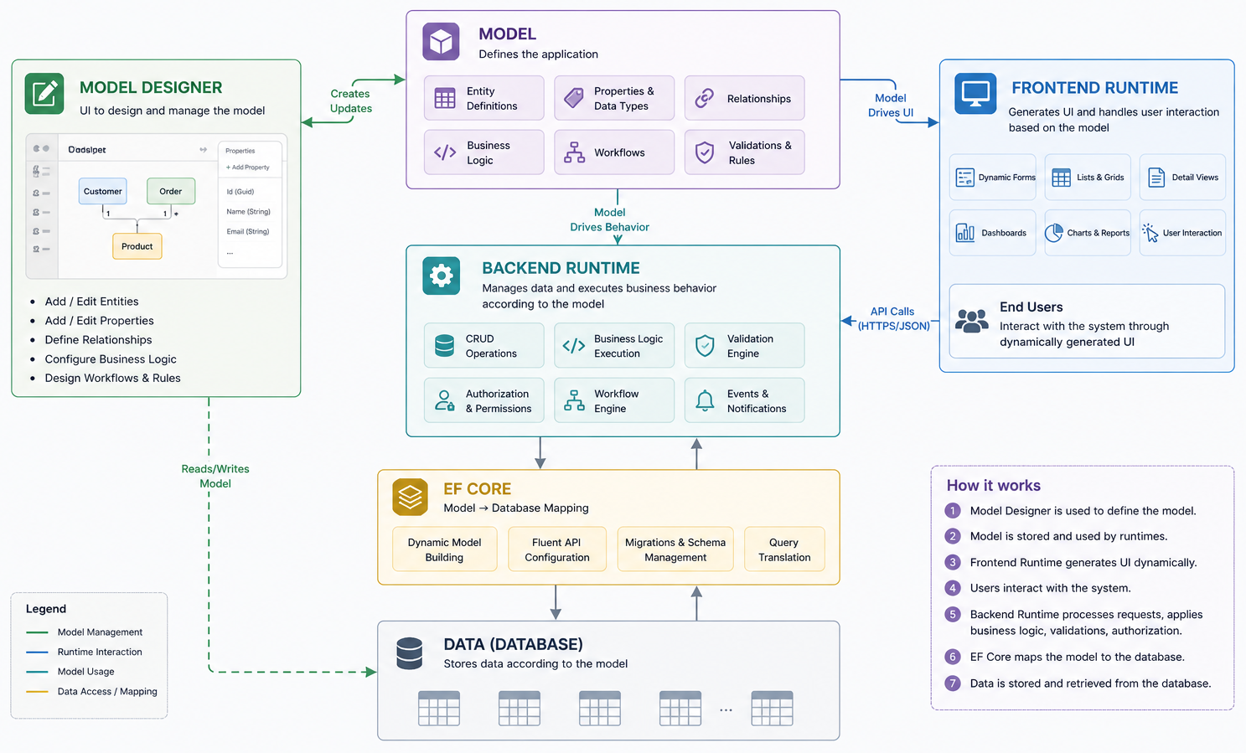
The Big Picture

Slide 9
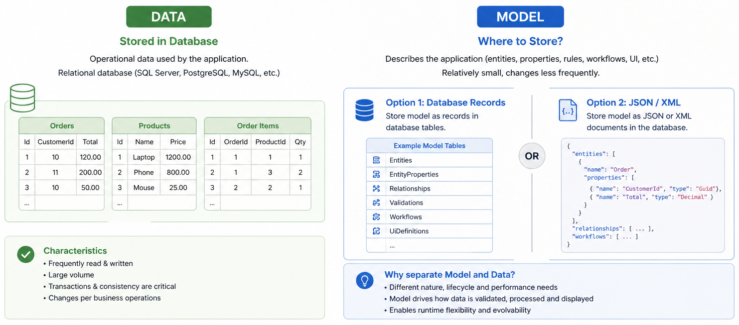
Model vs Data: Where Do We Store?

Slide 10
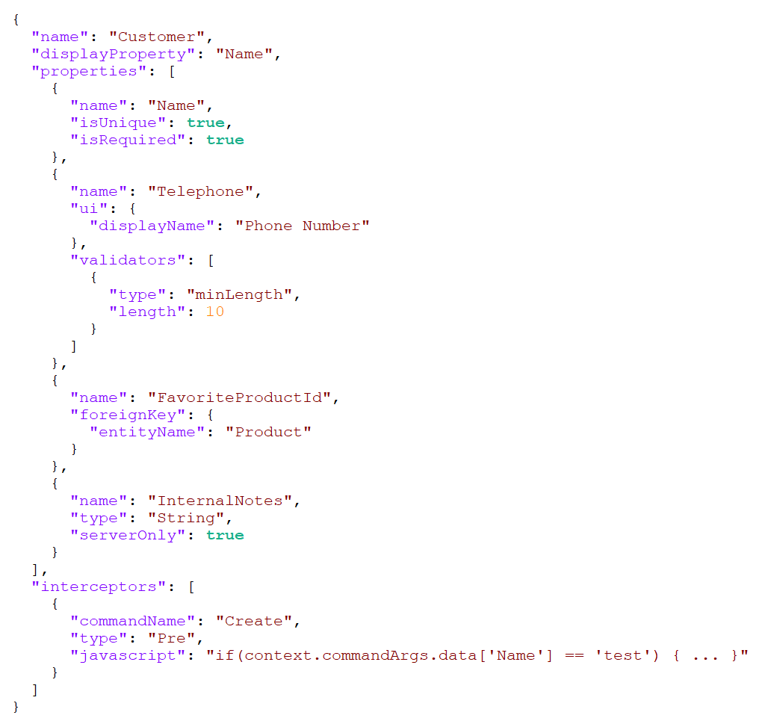
JSON-Based Dynamic Model

Slide 11
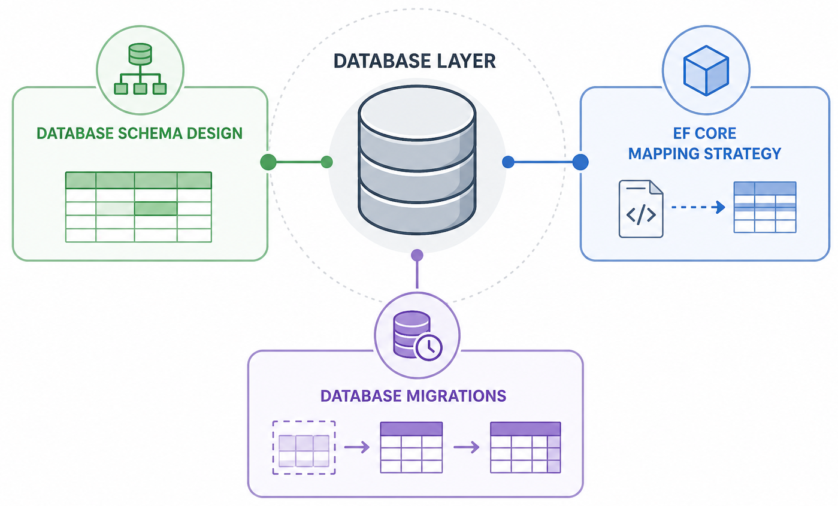
The Database Layer

Slide 12
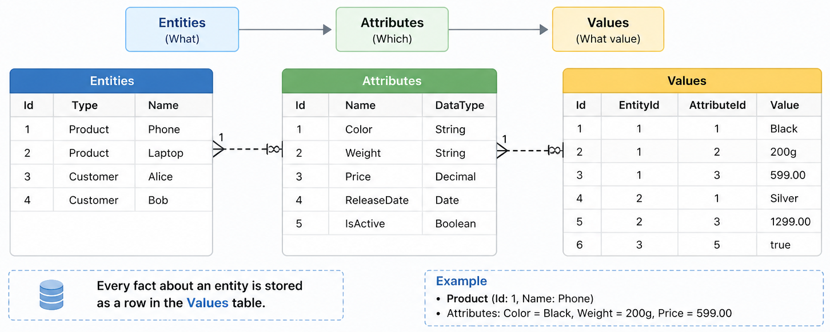
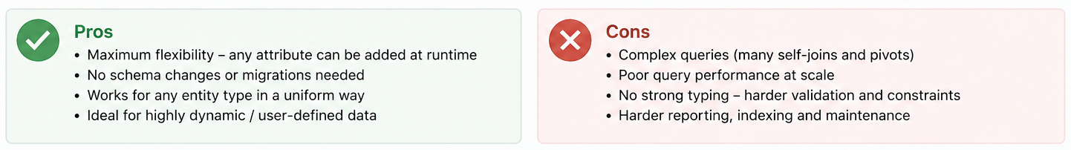
DB Schema: EAV (Entities-Attributes-Values)

Slide 13
DB Schema: Hybrid Approach
Table per Entity
Standard Fields for all tables: Id, CreationTime, IsDeleted, ConcurrencyStamp... etc.
DB Field Mapping for requested properties
JSON-Data for rest of the properties
All Dynamic Properties Are;
Filterable
Orderable
Possible to perform any kind of DB-level JOIN
DB-Level Indexable

Slide 14
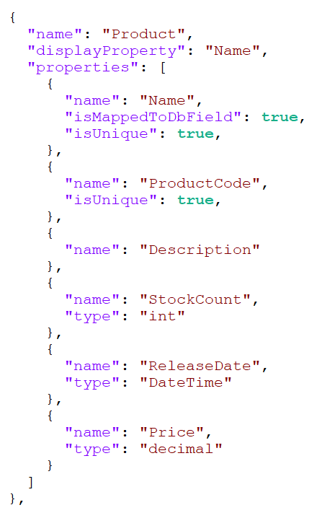
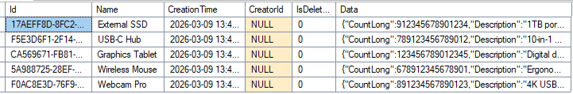
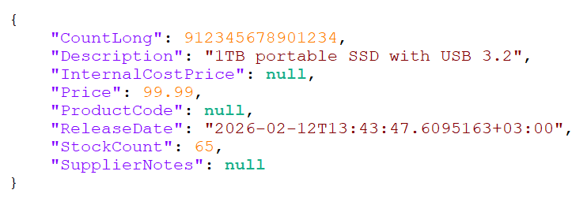
DB Schema: Example Hybrid Mapping
Standard Fields: Id, CreatorId, CreationTime, IsDeleted... etc.
DB-Mapped Fields: Name
JSON Data Fields

Slide 15
Entity Framework Core Dynamic Model Configuration

Slide 16
EF Core: Shared Type Entities
Product
EF Core feature: SharedTypeEntity: reuse one CLR type across many tables.
Table name = runtime entity name
Normal IQueryable per logical entity
No code-gen, no hundreds of empty classes
DynamicEntity
Customer
Order
Invoice

Slide 17
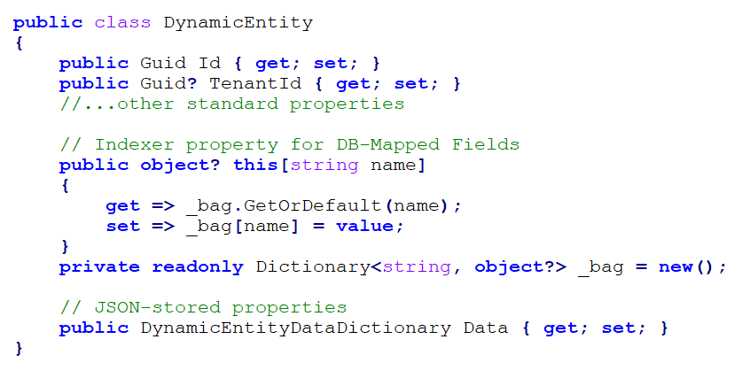
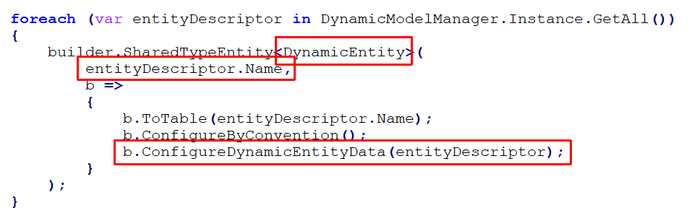
EF Core: Shared Type Entities | Example

Slide 18
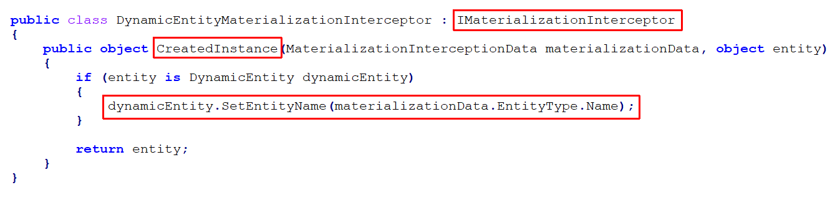
EF Core: Shared Type Entities | Example

Slide 19
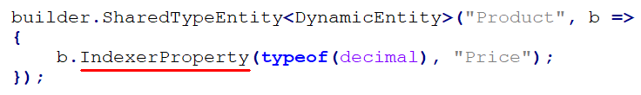
EF Core: Indexer Properties
No Property on the Entity Type → Maps to a Field in the Database Table
Cheaper WHERE / ORDER BY — native SQL paths
Indexable, type-checked, query-translatable

Slide 20
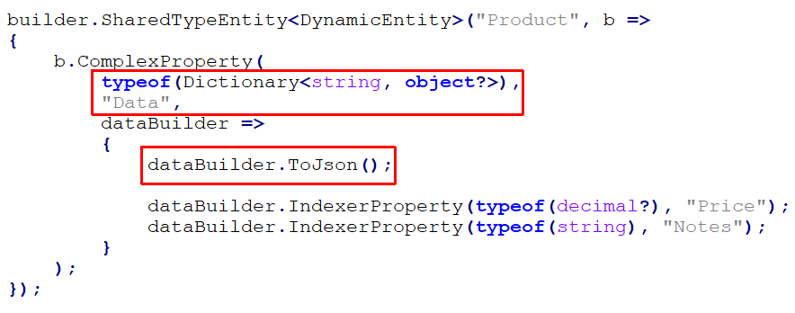
EF Core: Map to JSON Column
Mapped via owned/JSON entity configuration
No schema migration when users add a field

Slide 21
Entity Framework Core Runtime Model Changes

Slide 22
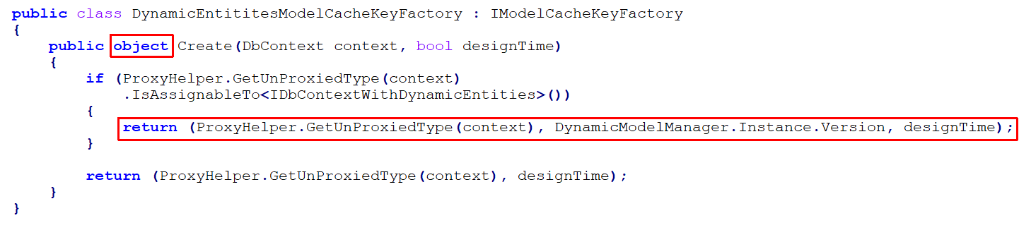
EF Core: Invalidating the DbContext Model Cache
EF Core Caches the DbContext Model > OnModelCreating method runs only once

Slide 23
EF Core: Migrating the DB Schema
Creating Tables, Fields... On runtime, not design time!

Slide 24
Dynamic Model: Layering
Runtime DB — highest priority — user-defined entities
File / fluent — ops or code-shipped configuration
Compile-time code — baseline shape and defaults
Same graph → EF model + API + UI.
Runtime DB (highest)
File / fluent
overrides
Compile-time code

Slide 25
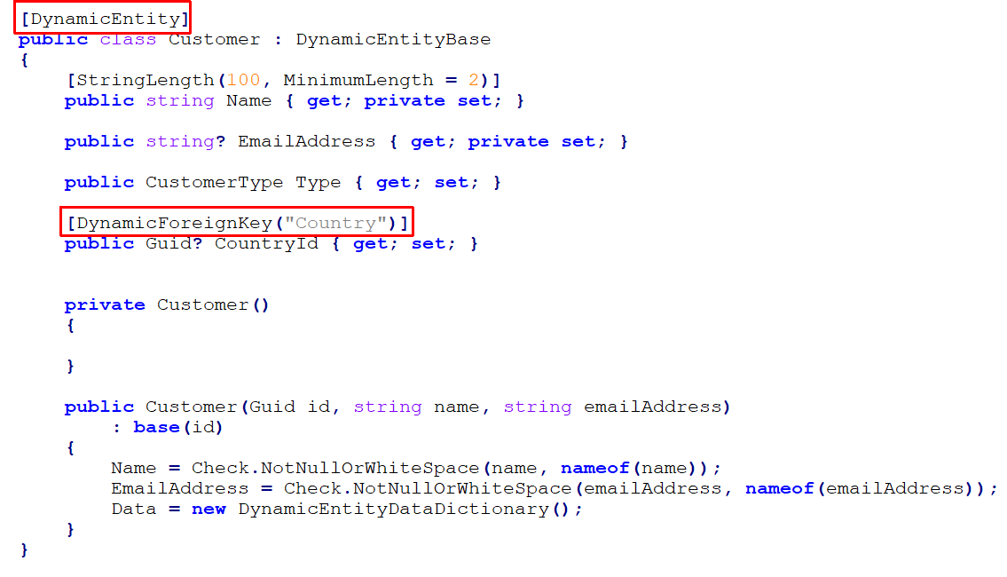
Example: C# Dynamic Entity Class

Slide 26
Key EF Core Structures
SharedTypeEntity -> Map single C# class to multiple database tables Get DbSet -> DbContext.Set<DynamicEntity>("EntityName")
Indexer Properties -> Map a dynamic property to a static DB table field
JSON Column -> Map multiple dynamic properties to a single JSON field in the database
ModelCacheKeyFactory -> Apply runtime schema changes to EF Core model
Dynamic LINQ --> System.Linq.Dynamic.Core & LinqKit.Core libraries

Slide 27
THANKS FOR
LISTENING
Download the Presentation
Halil İbrahim Kalkan
Co-founder, Volosoft
hibrahimkalkan
hikalkan

